Slide 1
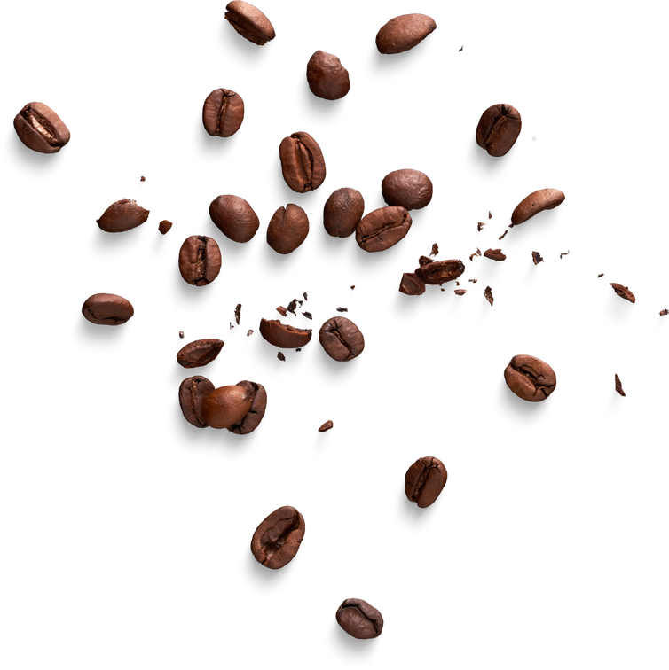


SILO’s Coffee Shop
SILO’s Coffee shop Analysis
A sip to savor in every cup.
PRESENTED BY
Silondile Mkhize

Slide 2

SILO's Coffee Shop
Content Page
Introduction
Analysis Breakdown
Conclusion & Recommendations
Q & A

Slide 3
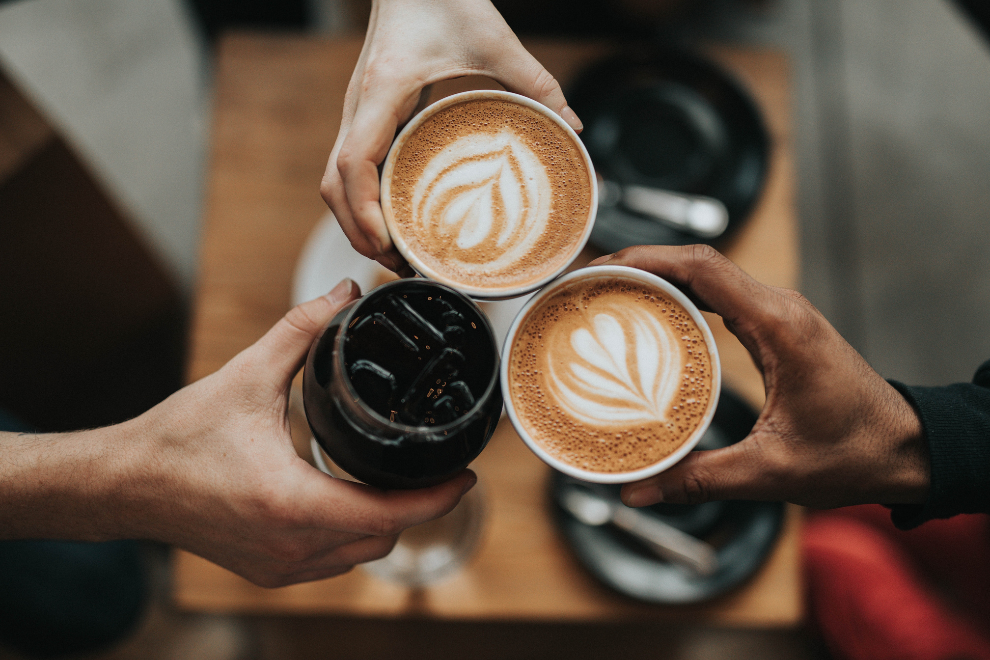
SILO's Coffee Shop
Problem statement
Silo’s Coffee Shop is a growing chain of coffee shops. Silo’s Coffee Shop is on a mission to grow the company’s revenue and improve product performance. We are looking to use the data and market insights to develop new strategies.
Focus areas:
Product performance
Store performance
Marketing strategy
Pg 1

Slide 4
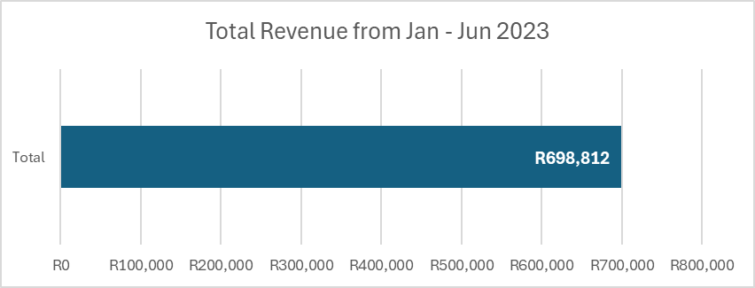
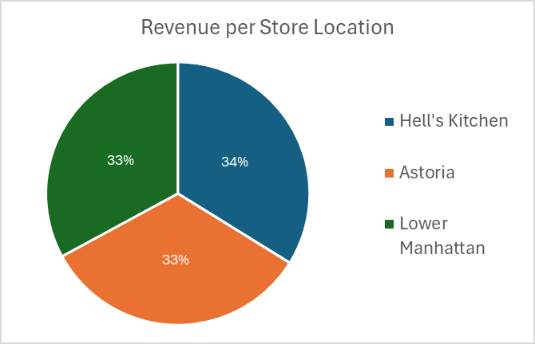
Revenue 2023
SILO's Coffee Shop
The graph shows the % split of revenue across the 3 shops. The revenue is almost evenly split between the 3 shops.
Total revenue across the 3 coffee shops in the chain of stores.
Pg 2

Slide 5
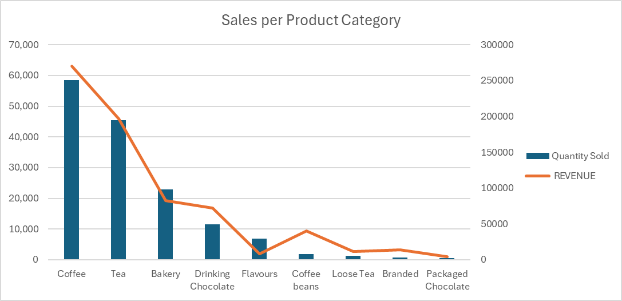
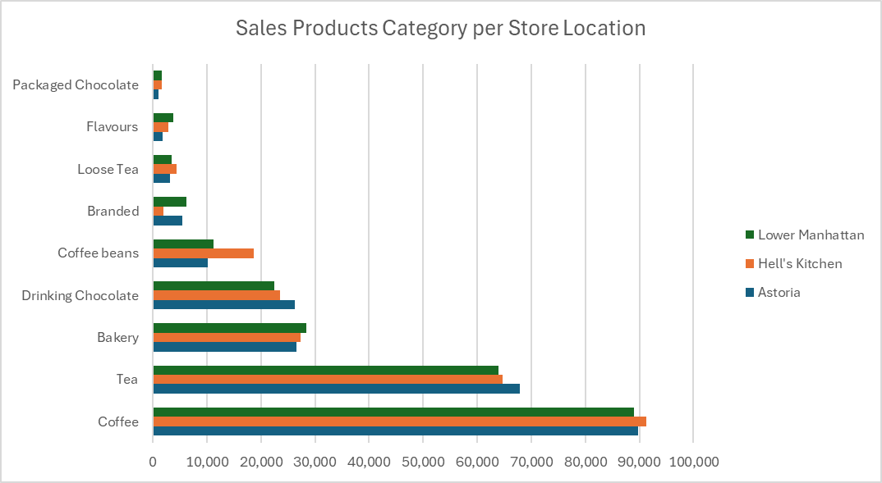
Product offering analysis
SILO's Coffee Shop
Coffee and Tea are the most sold product that brings in the highest revenue.
We sell more units of flavours than Coffee beans, but Coffee beans brings in more revenue than flavours. Coffee beans is the 5th highest revenue producing products. Coffee beans contribute 5.74% of total revenue.
The Top 3 products Coffee, tea and Bakery make up the below total store sales:
79% for Astoria,
78% for Hell’s kitchen,
78% for Lower Manhattan
Pg 3

Slide 6
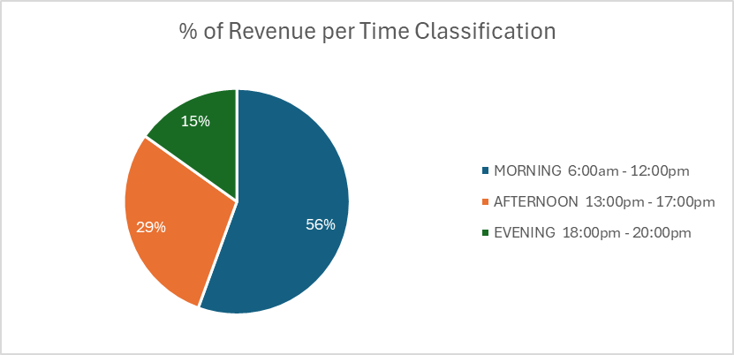
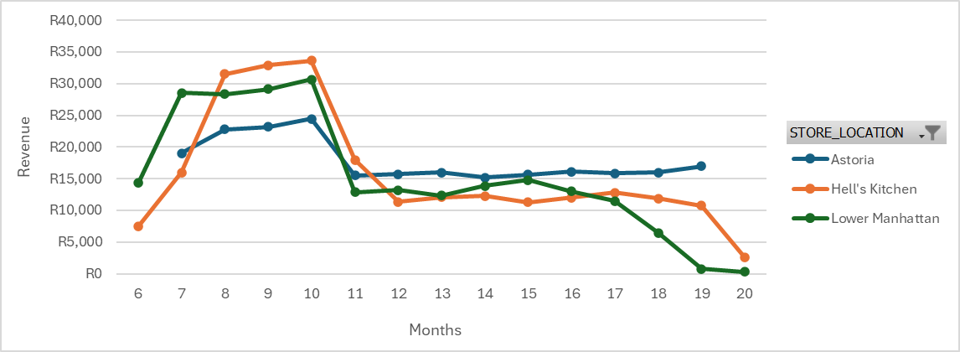

Time data analysis
SILO's Coffee Shop
56% of the sales are made in the morning. Only 9% of the revenue is made in the last 3 hours of the day between 18:00pm – 20:00pm. Compared to 24% revenue made in the first 3hrs of the day.
Pg 4

Slide 7
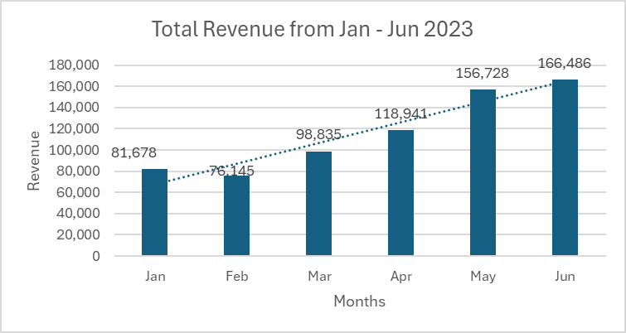
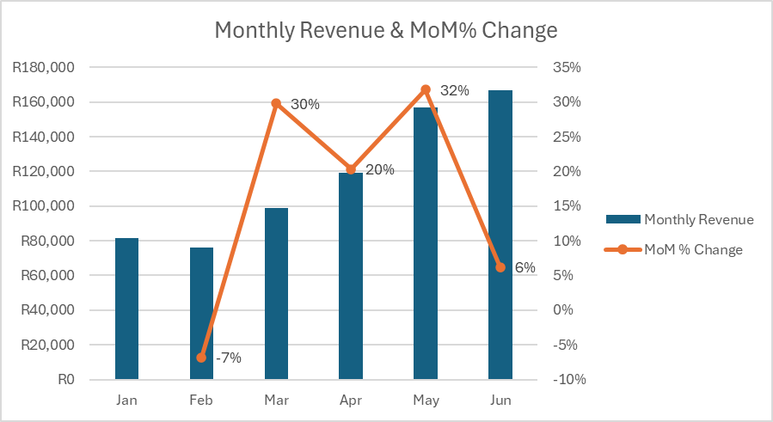
Revenue per Month & MoM% Change
SILO's Coffee Shop
  The last 3 months 63% of the revenue, the first 3 months Jan-March only produced 37% of the revenue.
  There was +30% revenue increase between Feb and Mar. There is an over all up trend in the revenue generated.
Pg 5

Slide 8
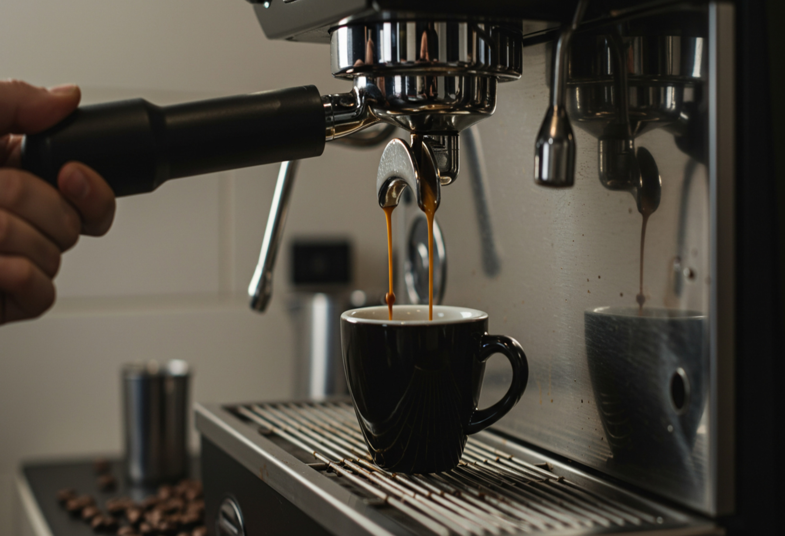
Conclusion and Recommendation
SILO's Coffee Shop
Conclusions
There is an uptrend in revenue across the various locations since Jan – June 2023. Coffee and Tea generate the most sales for the stores across the locations.
Recommendations
Advertising can be done to bring Lower Manhattan’s sales up to be inline with the other two store locations.
The Astoria and Lower Manhattan store location could possibly move the closing time to 19:00pm, because less that 0.5% of sales happen during that last hour.
More advertising/ promotions can be introduced for the coffee beans. This product has the potential to bring in more revenue.
We can look into promoting or taking away the Branded and package chocolate as a product offering.

Slide 9
SILO's Coffee Shop
Q & A
Thank you
PRESENTED BY
Silondile Mkhize
Pg 6

